Slide 1
Class – 2

Slide 2
Functions
We implement code that we want to use over and over again at different places.
This can make the over all code very large.
We can use functions
Defining a function
  Def hello():
    Print(“Hello”)

Slide 3
Parameters
Def print_sum(number1,number2):
  Print(number1 + number2)
Return value
  The keyword return is used to return the function result back as a variable
  Def add(num1,num2):
    Return num1+num2
Default parameter
Def say(text=“Hello”)
print(text)

Slide 4
Scope
Scope is not only important for functions but also important for loops.
Local and global variable
# program show local and global variable

Slide 5
String Functions
Name,age = “john”,25
Print(“My name is {} and I am {} years old”.format(name,age))
Placeholders
Placeholders | DataType
%c | Character
%s | String
%d or %i | Integer
%f | float

Slide 6
Case Manipulating Functions
Function | Description
String.lower() | Converts all letters to lowercase
String.upper() | Converts all letters to uppercase
String.title() | Converts all letters to title case
String.capitalize() | Converts first letter to upper case
String.swapcase() | Swaps the case of all letters

Slide 7
Count, Find , Replace and Split Function
Counts – counts how many times a specific string occurs in another string
Find – the first occurrence of a certain string in another string
Join – With the join function we can join a sequence to a string and separate each element by this particular string
Replace – One string within a text by another one.
Split – we want to split specific parts of a string and put them into a list.

Slide 8
Modules NumPy
What is NumPy?
NumPy is a Python library used for working with arrays.
It also has functions for working in domain of linear algebra, fourier transform, and matrices.
NumPy was created in 2005 by Travis Oliphant. It is an open source project and you can use it freely.
NumPy stands for Numerical Python.
Why Use NumPy?
In Python we have lists that serve the purpose of arrays, but they are slow to process.
NumPy aims to provide an array object that is up to 50x faster than traditional Python lists.
The array object in NumPy is called ndarray, it provides a lot of supporting functions that make working with ndarray very easy.
Arrays are very frequently used in data science, where speed and resources are very important.

Slide 9
Numpy install
Pip install numpy
Import numpy

Slide 10
Data Types in NumPy
NumPy has some extra data types, and refer to data types with one character, like i for integers, u for unsigned integers etc.
Below is a list of all data types in NumPy and the characters used to represent them.
i - integer – (Python)
b - Boolean – (Python)
u - unsigned integer
f - float – (Python)
c - complex float
m - timedelta
M - datetime
O - object
S - string – (python)
U - unicode string
V - fixed chunk of memory for other type ( void )

Slide 11
Module Pandas
What is Pandas?
Pandas is a Python library used for working with data sets.
It has functions for analyzing, cleaning, exploring, and manipulating data.
The name "Pandas" has a reference to both "Panel Data", and "Python Data Analysis" and was created by Wes McKinney in 2008.
Why Use Pandas?
Pandas allows us to analyze big data and make conclusions based on statistical theories.
Pandas can clean messy data sets, and make them readable and relevant.
Relevant data is very important in data science

Slide 12
Getting started Pandas
Pip install pandas
Import pandas
# reading file with pandas
import pandas as pd
df = pd.read_csv('data.csv')
print(df.to_string())

Slide 13
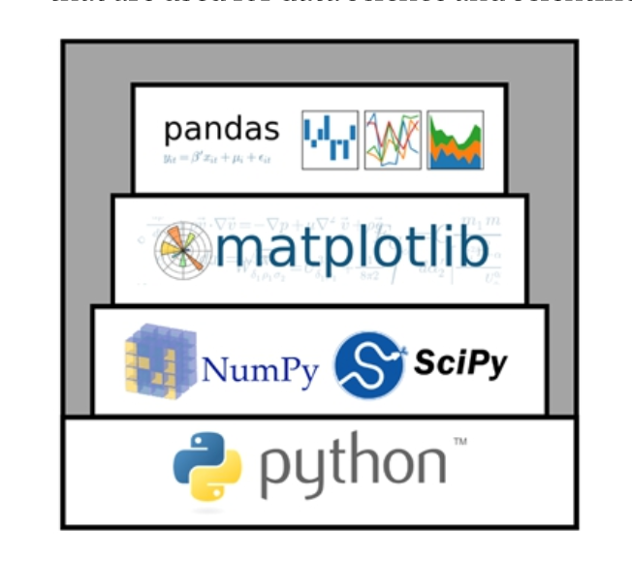
Installing Modules

Slide 14
Types of Python Environments
Global Environment
Local Environment
  Virtual Environment (venv)
  Conda Environment (https://conda.io/projects/conda/en/latest/user-guide/getting-started.html)

Slide 15
Python Environment tools
Pip ( install python3-pip)
Venv (install python3-venv)
Conda ( installed with miniconda)

Slide 16
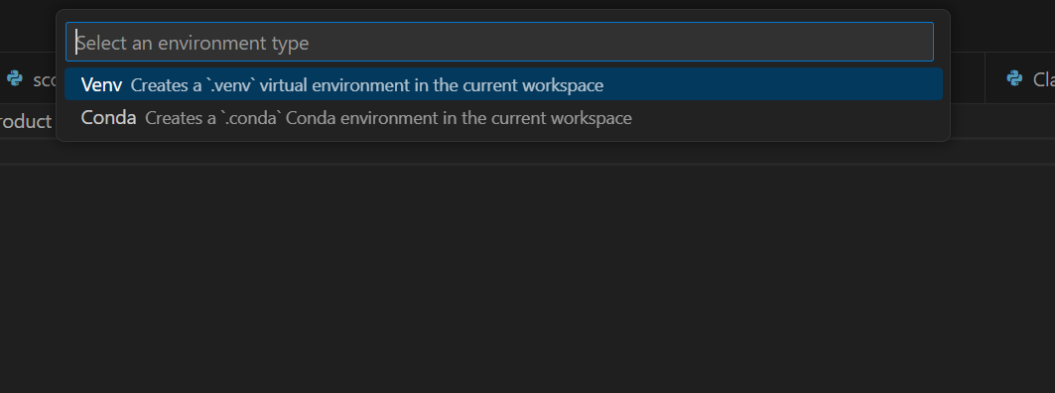
Creating Environments
Ctrl+shift+P search for the python : Create Environment command and select it.

Slide 17
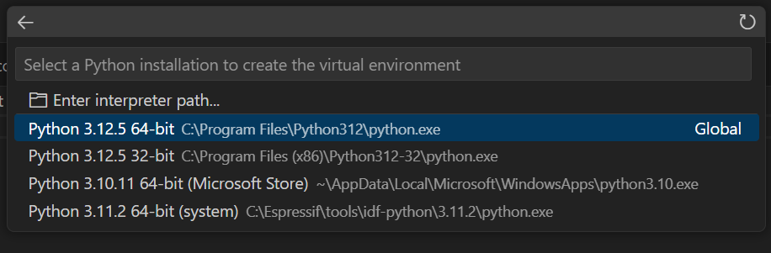
Commands to run

